Slide 1
Health Access Before & After the ACA
CTEC 128
Saniya i, cali g, jada l, Christopher m, kerin q
Professor stephanie miller

Slide 2

introduction

Slide 3
The goal of this project is to explore how changes to the Affordable Care Act (ACA) could affect healthcare access and coverage. The ACA, enacted in 2010, aimed to broaden access to health insurance, reduce costs, and improve health outcomes, particularly for low-income individuals. If key provisions of the ACA are rolled back, potential repercussions could include reduced access to insurance, higher healthcare costs, increased health disparities, decreased access to preventive services, greater financial strain on healthcare systems, and fewer employer-sponsored insurance plans.

Slide 4
Healthcare policy plays a crucial role in shaping the accessibility, affordability, and quality of medical care available to the public. One of the most significant healthcare policy reforms in recent history is the Affordable Care Act (ACA), which was enacted in 2010 with the aim of transforming the U.S. healthcare system. The ACA sought to address critical issues such as high rates of uninsured individuals, rising healthcare costs, and inequities in access to care.

Slide 5

Literature review

Slide 6
concepts and ideas
•health care
-history- discrimination- Programs/policies
-finance- History of affordability
-race/gender prominent related issues

Slide 7
Context and Problem Statement
If the ACA were repealed, as proposed in political debates, this would have profound impacts on healthcare coverage and health outcomes, particularly for vulnerable populations. Project 2025 could aim to enhance or adjust these reforms to address current gaps in the system, promoting sustainable, equitable healthcare policies for the future. Millions could possibly lose health insurance, there could also be a return of preexisting condition exclusions, lastly one that could definitely effect us; elimination of young adult coverage.

Slide 8

Project overview

Slide 9
Overview
The overview of this project is the effect of health care policies on the public. In the previous debate, Trump stated that he wants to discontinue the Affordable Care Act without having a backup plan that’s affordable for the economy. This policy could affect everyone. Therefore, without affordable healthcare, individuals may have limited access to necessary treatments, leading to worsened health outcomes, untreated conditions, and increased healthcare costs.

Slide 10
Data/analytic questions
What is the distribution of health insurance coverage among different age groups?
How do health insurance coverage rates vary among different racial groups?
Which income range relies on government assisted health care the most?
What was the average income of uninsured individuals 2008, for the state of California?
What is the percentage of men that have health cover compared to the percentage of women that does?

Slide 11

Data ingestion

Slide 12
Collected by: U.S. Census Bureau
Purpose: Provides detailed demographic, social, economic, and housing data for research, policy, and planning.
Frequency: Ongoing, annual updates (since 2005)
Focus Areas:
  Demographics: Age, sex, race, household composition
  Housing: Tenure, costs, home values
  Economics: Employment, income, occupation
  Social: Education, marital status, disability
Health Insurance: Coverage types and sources
Importance: Supports decision-making and resource allocation for federal, state, and local governments.

Slide 13
We selected data from 2008 (pre-ACA) and 2016 (post-ACA) to analyze changes in healthcare policy under the ACA. These years offer a clear comparison for examining trends in health insurance coverage and affordability, providing valuable insights into the ACA’s influence on public access to healthcare.

Slide 14
We selected California for analysis because it is the second most diverse state in the U.S., with a wide range of racial, ethnic, and socioeconomic groups. This diversity, combined with California's proactive ACA implementation through Covered California, makes it an ideal case study. The state’s population includes large Hispanic, Asian, and African American communities, as well as a mix of urban and rural areas, making it representative of different healthcare needs and challenges. California’s early adoption of the ACA and role in healthcare policy innovation provide a strong foundation for studying the ACA's impact. We chose 20,000 instances from the 2008 and 2016 datasets, offering comprehensive coverage of key variables and demographics, enabling a detailed yet manageable analysis of the ACA and potential future healthcare policies.

Slide 15
FINAL Features
We will use the following features from the American Community Survey (ACS) dataset:
Health Insurance Coverage
Income
Age
Gender
Race/Ethnicity
Geographic Location
These features provide a comprehensive overview of health care access and demographics, allowing for a detailed analysis of the impact of health care policies.

Slide 16
We are analyzing ACS data for the 18-64 age group to assess how the ACA affects working-age adults. This group is key because they rely more on employer-sponsored insurance, individual plans, or Medicaid, unlike those over 65 who qualify for Medicare.

Slide 17

Data wrangling

Slide 18
Core Wrangling Activities
Discovery: We explored the ACS dataset to understand its structure and identify key variables such as health insurance coverage and income, both of which are critical for analyzing the ACA's impact.
Cleaning: While the dataset is well-maintained, there were missing values, particularly in the income variable. We addressed this by excluding incomplete entries to maintain the integrity of the analysis.
Validating: We validated the data by cross-checking key variables like health insurance coverage to ensure consistency between the 2008 and 2016 datasets. This ensures the data is accurate and reliable for analysis.
Feature Engineering
Aggregation: We combined related features to simplify the dataset and highlight key patterns.
Normalization: Applied normalization to ensure consistency across features with different scales for accurate comparison.
Categorization: Converted numerical columns into categorical ones where applicable to facilitate analysis.
Data Errors and Issues
Missing Values:
  Issue: Columns like income and others have missing values.
  Resolution: We addressed missing values through imputation or exclusion, depending on the context.

Slide 19

Exploratory Data Analysis

Slide 20
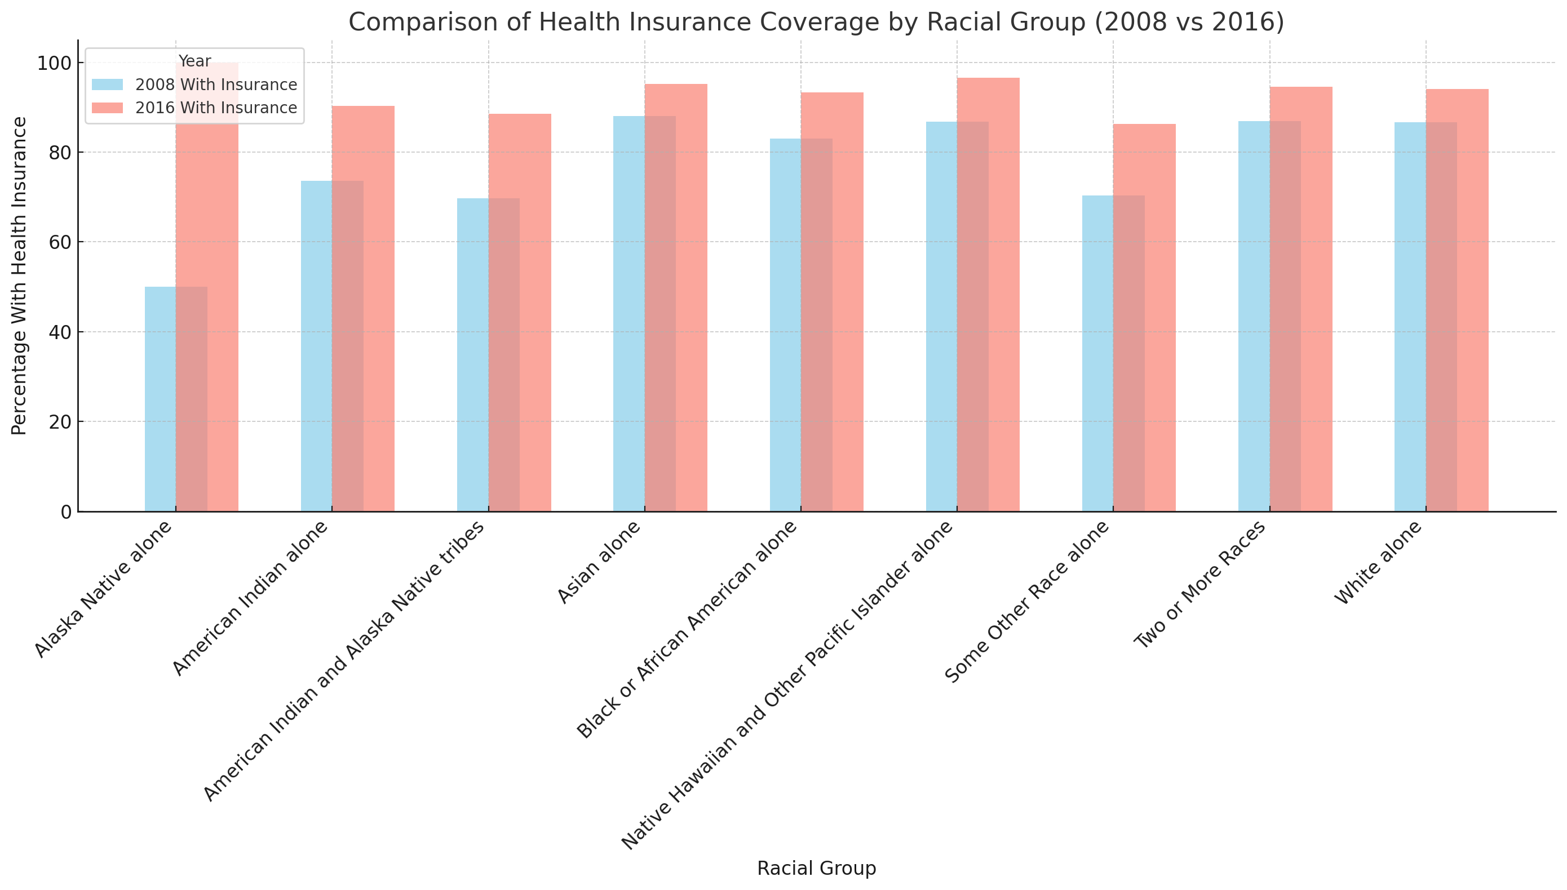
This chart shows the health insurance coverage rates across racial groups in California for 2008 and 2016, before and after the ACA. Blue bars represent 2008, and red bars represent 2016. The data reveals a significant increase in coverage for most groups, especially among Some Other Race alone and Black or African American alone individuals, demonstrating the ACA's role in expanding access to previously underserved communities.

Slide 21
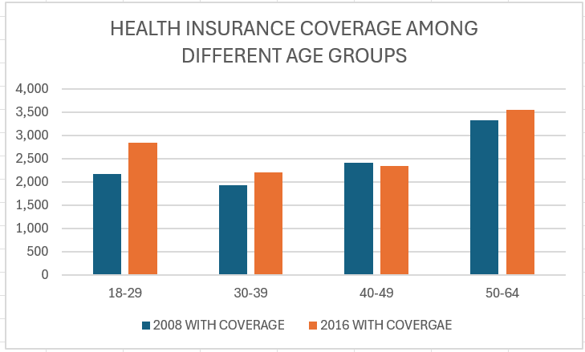
This graph shows the distribution of health insurance coverage among different age groups.

Slide 22
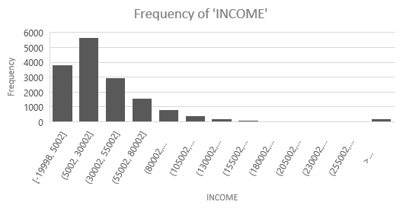
Income Frequency of Californians on Medicaid or Government Assistance
This chart shows the frequency income of CA who rely on Medicaid, Medical Assistance, or any kind of government-assistance plan for those with low incomes.

Slide 23
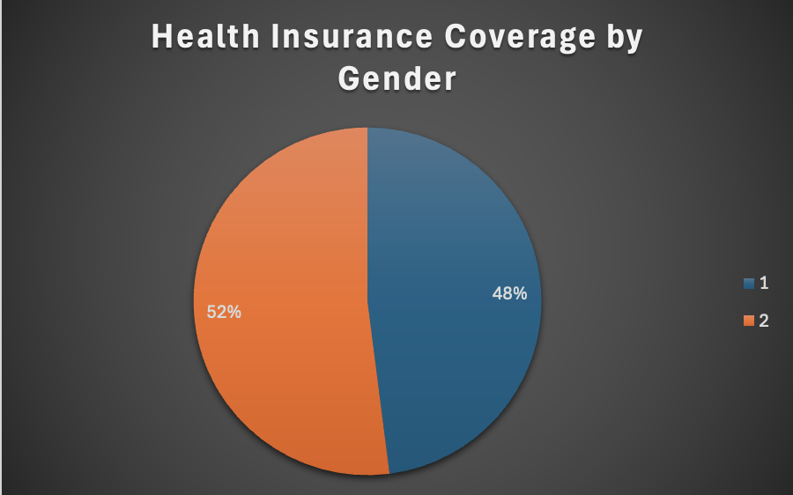
This graph shows the percentage of men that haVE health insurance compared to the PERCENTAGE OF WOMEN in california out of 20,000 people
1 = MALE
2 = FEMALE

Slide 24
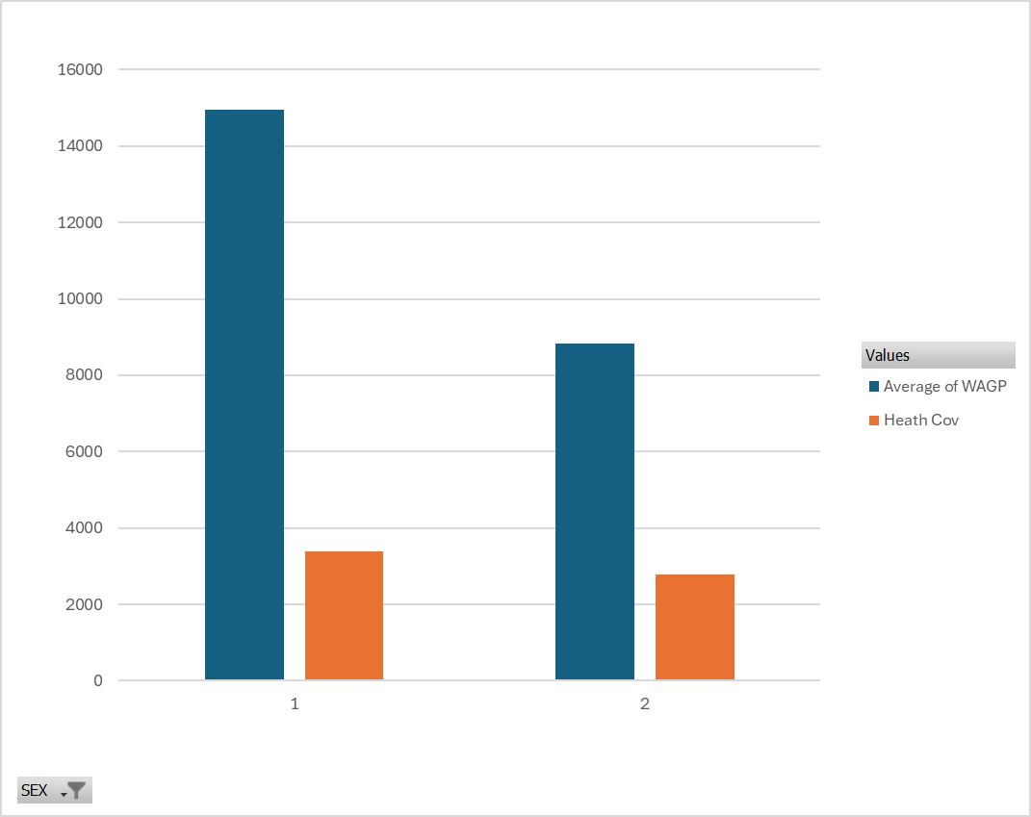
Average income of uninsured individuals
Notes:
1=Men " This shows the average of income and how many individuals with health insurance"
2=Women

Slide 25

Data insights

Slide 26
Learnings from the Data: The ACA had a positive impact on healthcare access, especially for low-income individuals and minorities in California. Insurance coverage rates significantly increased between 2008 and 2016. Vulnerable populations, particularly those who benefited from Medicaid expansion, saw the largest improvements.
Actionable Insights: Policymakers should consider preserving or improving ACA provisions, particularly those that expand healthcare access to low-income and minority populations.
Connecting Insights to Data:
The majority of those in need if government health care assistance are women over the age of 50, with the largest population of them having incomes between $5,002 and $30,002.

Slide 27

Project challenges
Project challenges and pitfalls: We encountered obstacles like inconsistent data, missing information, and the requirement for advanced feature engineering.
What would the team do differently next time: We would make sure we select a topic with available data. We struggled to find relevant data from the ACS for the original topic.
If you have more time, what more would the team do to achieve the project goals and objectives: We could expand the data scope to include data from more states and age groups. We as well could analyze more than 2 years of data.

Slide 28

Future projects
What would you do differently if you had more time: We could incorporate more socioeconomic factors, such as education, housing costs, and employment status, to explore how these elements influence healthcare access alongside income and insurance status.

Slide 29
References
https://www.census.gov/programs-surveys/acs
https://www.kff.org/health-policy-101-the-politics-of-health-care-and-the-2024-election/?entry=table-of-contents-health-reform-in-elections
https://www.healthcare.gov/where-can-i-read-the-affordable-care-act/

